Slide 1
ENGR-304-L
Software Lab 06

Slide 2
Agenda
Attendance
Recap
Polling vs Interrupts
The ISR
Control Registers
Getting Started

Slide 3
Recap
Bit-Masks
IO Devices
PIO Core & Timer - Altera DE2 IO Devices

Slide 4
Interrupts
Start
Input devices sometimes use polling
Main routine repeatedly reads/checks input
Key
Pushed?
No
Yes
Do Something

Slide 5
Interrupts
Start
Input devices sometimes use polling
Main routine repeatedly reads/checks input
Polling can have poor performance
Poll period fast, wasted checks
Poll period slow, delayed reaction
Polling multiple inputs can add complexity
Polling can also sometimes be the best solution
Key
Pushed?
No
Yes
Do Something

Slide 6
Interrupts
Start
Interrupts are an alternative to polling
When input changes, take action immediately
After taking action, resume where interrupted
Key
Pushed!
Do Something

Slide 7
Interrupts
Start
Interrupts are an alternative to polling
When input changes, take action immediately
After taking action, resume where interrupted
Interrupts require hardware support
Interrupt may alter behavior upon resume
Key
Pushed!
Do Something

Slide 8
Interrupts
Communication Example
Polling ~ mailbox
Interrupts ~ phone call
Carpooling Example
Polling ~ waiting by the door
Interrupts ~ hearing the doorbell
Useful comparison & justification for each technique:
https://techdifferences.com/difference-between-interrupt-and-polling-in-os.html

Slide 9
Interrupt Service Routine (ISR)
CPU executing main routine, until interrupt occurs
Main routine is paused, ISR is executed (like a function call)
Main resumes after ISR “returns”
ISR may need to receive data from main routine
ISR may alter data to change behavior in the main routine

Slide 10
Interrupt Service Routine (ISR)
Execution Timing Sequence Diagram
Main is executing
Device generates interrupt
Main pauses
ISR executes
Main resumes
Main Routine
ISR
Device
Time Start
Interrupt
Time End

Slide 11
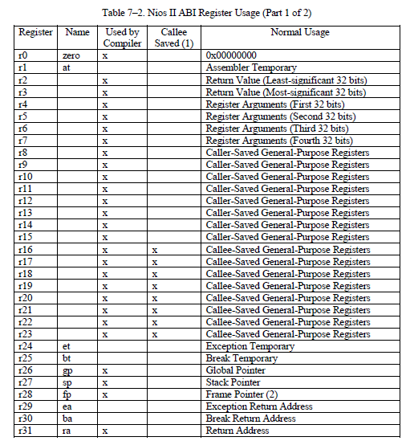
Control Registers
So far… 32 registers

Slide 12
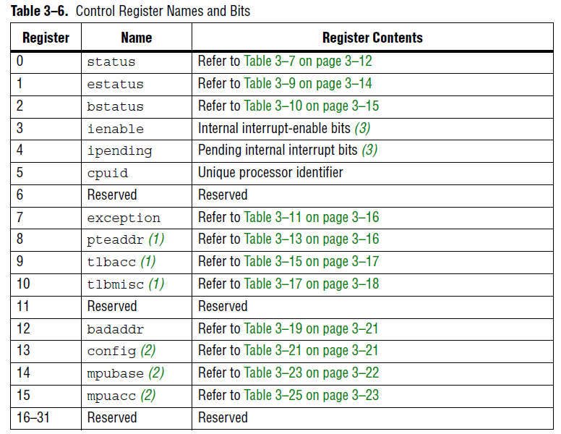
Control Registers
So far… 32 registers
Now… add 16 more

Slide 13
NIOS Instructions & Registers
Instructions:
rdctl
wrctl
eret

Slide 14
NIOS Instructions & Registers
Instructions:
rdctl = read the value from a control register into a register, similar to mov
wrctl = write the value from a register into a control register, similar to mov
eret = return from the ISR

Slide 15
NIOS Instructions & Registers
Instructions:
rdctl
wrctl
eret
Control Registers:
ienable
status
ipending
estatus

Slide 16
NIOS Instructions & Registers
Instructions:
rdctl
wrctl
eret
Control Registers:
ienable = Allows enabling interrupts by #, each bit gets an interrupt #
status = Setting the PIE bit enables interrupts for the whole CPU
ipending = Holds flags for which interrupt(s) are asserted
estatus = Location to preserve status control register values during ISR

Slide 17
NIOS Instructions & Registers
Instructions:
rdctl
wrctl
eret
Control Registers:
ienable
status
ipending
estatus
Registers:
sp
et
ea

Slide 18
NIOS Instructions & Registers
Instructions:
rdctl
wrctl
eret
Control Registers:
ienable
status
ipending
estatus
Registers:
sp = shared by main & ISR, does not need to be protected, used in the same way
et = temporary register for use during ISR without protection
ea = like ra but for eret instead of ret

Slide 19
NIOS Instructions & Registers
Instructions:
rdctl
wrctl
eret
Control Registers:
ienable
status Refer to the reference docs!
ipending
estatus
Registers:
sp
et
ea

Slide 20
NIOS Interrupt Execution Sequence
Execution Timing Sequence Diagram
Main is executing
Device generates interrupt
Main pauses
CPU HW copies PC to EA
CPU HW copies status to estatus
CPU HW prevents further interrupts
CPU HW sets PC to ISR’s location
ISR executes
Checks interrupt assertions
Handles interrupts
Clears interrupt assertions
Main resumes
Restores estatus to status
Restores EA to PC
Re-allows interrupts
Main Routine
ISR
Device
Time Start
Interrupt
Time End

Slide 21
NIOS Interrupt Setup
Interrupt Enabling
Enable the device’s interrupts (ex: set mask register)
Enable the CPU’s interrupts by #
Clear any left-over interrupt flags
Enable the CPU’s interrupts globally (status PIE to 1)

Slide 22
NIOS Interrupt Setup
Interrupt Enabling
Enable the device’s interrupts (ex: set mask register)
Enable the CPU’s interrupts by #
Clear any left-over interrupt flags
Enable the CPU’s interrupts globally (status PIE to 1)
ISR Creation
Correct EA if external interrupt (code given)
Push registers to the stack if needed
Check each enabled CPU interrupt by #
Handle asserted interrupts by taking action
Clear interrupt flags (ex: Timeout bit)
Pop registers from the stack if needed
Use eret to resume main routine

Slide 23
Lab SW06 Tips
Lab SW06 builds on SW05, but use the new template files
Read the template files and comments closely, becomes familiar with them before inserting your own code
Don’t forget to initialize IO devices before use (if needed)
Don’t forget to protect registers on the stack during the ISR (except r0, sp, et, ea)
Refer to “NIOS IO” and “NIOS Interrupts” slide decks for details & examples

Slide 24
Getting Started
Setup project directory for SW06 on the H: drive
Download SW06 files from Moodle or S: drive
Start following directions in the lab assignment document

Slide 25
Lab Components
Altera DE2 Board
Windows 10 PC
Quartus
FGPA
Peripheral Devices
(Ex: switches, buttons, hex displays)
NIOS Processor Image
NIOS Processor Image
(Flashed)
Switches
Keys
Software (Executing)
Altera DM
LEDs
NIOS Processor Image
7Seg Displays
Timer
Software (Loading/Debugging)

Slide 26
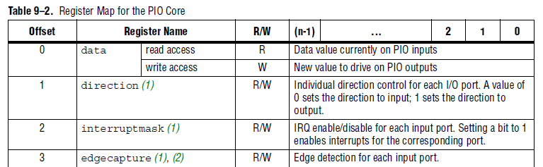
PIO Core (Peripheral I/O device/port)

Slide 27
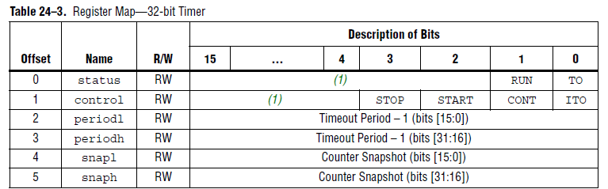
Interval Timer Core

Slide 28
Control Registers

